Slide 1
Purpose of this deck
Speaker: | In-house Specialist, Microsoft Spokesperson or Partner (Leader/Exec/SME)​
Audience: | Business Decision Maker, Line of Business Owner or an IT Decision maker
Title: | Transition to Synapse Link – simplify data integration
Length & Version: | 30 minutes, last updated Dec 2023
Content Level: | Level 200 for external & internal use
Deck Contacts: | Microsoft Product team: Jila Yadav, Milinda Vitharana, Jason Huang, Rich Black, Steven Koppens
Desired Outcomes: | Clear understanding of benefits, effort to transition from BYOD, Export to Data Lake to Synapse Link and Microsoft Fabric Proof of concept or planning workshop with an inhouse specialist, Microsoft Services or Partner
Usage Guide: | Slides should be adaptive to the specific audience situation – feel free to reorder slides, hide slides, etc. that you feel fit with your audience and the products they currently use.
Notes:
The purpose of this presentation is to provide you with an example of how best to present this Level 100 pitch deck to non-technical, business decision makers (BDMs). This external facing deck is intended to provide an overview of Dataverse + Microsoft Fabric solution.
For your reference, every slide has comprehensive notes that you can review later. The notes are intended to guide you during customer conversations, so you are empowered with accurate talking points and relevant statistics. Included in the deck are additional industry use cases and features coming soon that you can leverage.

Slide 2
Dynamics data in Synapse Link for Dataverse - Transitioning from Export to Azure Data Lake to Synapse Link

Slide 3
If you are using Export to Data lake today…
… check out the TechTalk series on this topic also!
Tables folder
(Virtual data warehousing)
Talk #2
Synapse &
Microsoft Fabric
(Lakehouse architecture)
Talk #4
Overview
Talk #1
Upgrade to Synapse Link*
Low code insights & action
Change feeds
(Cloud data warehousing & incremental ingestion)
Talk #3
https://aka.ms/TransitiontoSynapseLinkVideos

Slide 4
Agenda
What is Synapse Link for Dataverse
What is links to Microsoft Fabric
Transitioning from Export to data lake
Architecture pattern & transition guidance
Additional resources

Slide 5
Synapse Link for Dataverse
1
One experience to integrate all Dynamics 365 data for analytics
Notes:
Synapse Link provides access to all your Dynamics data in one experience, enabling you to connect your Microsoft Dataverse data to Azure Synapse Analytics where you can explore your data and accelerate time to insight.

Slide 6

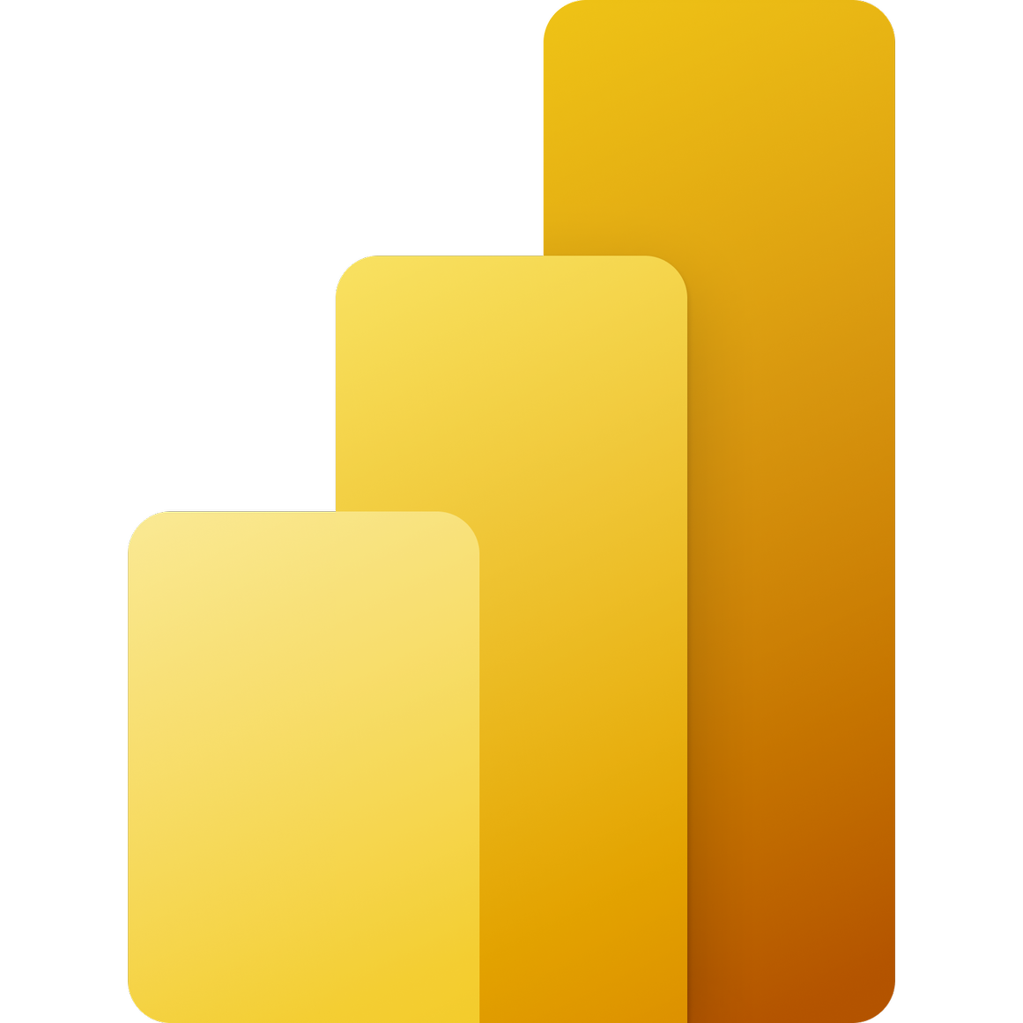
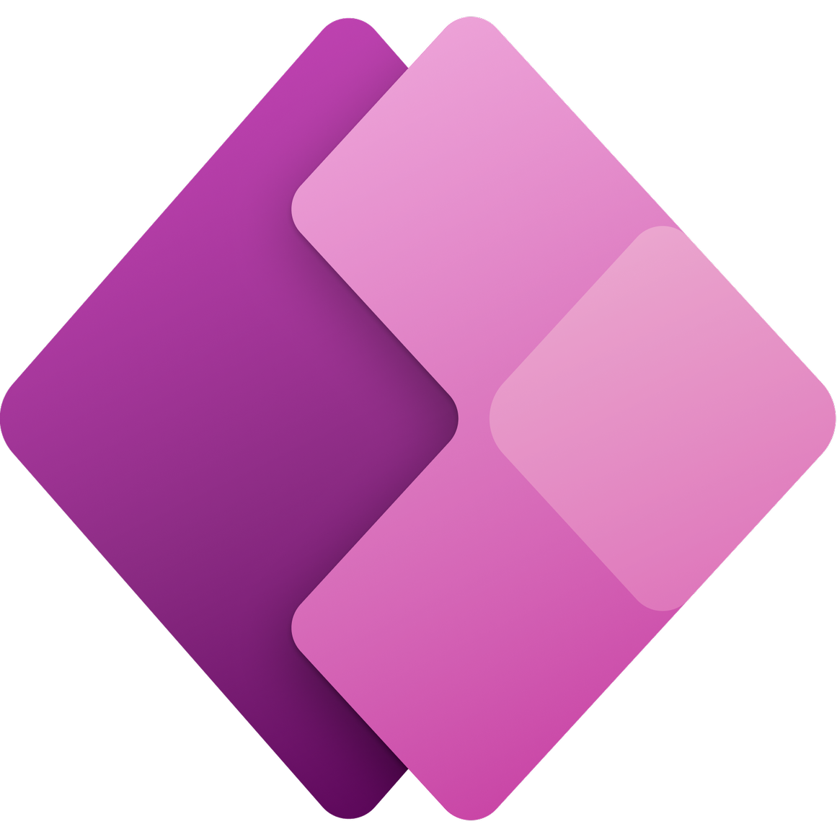
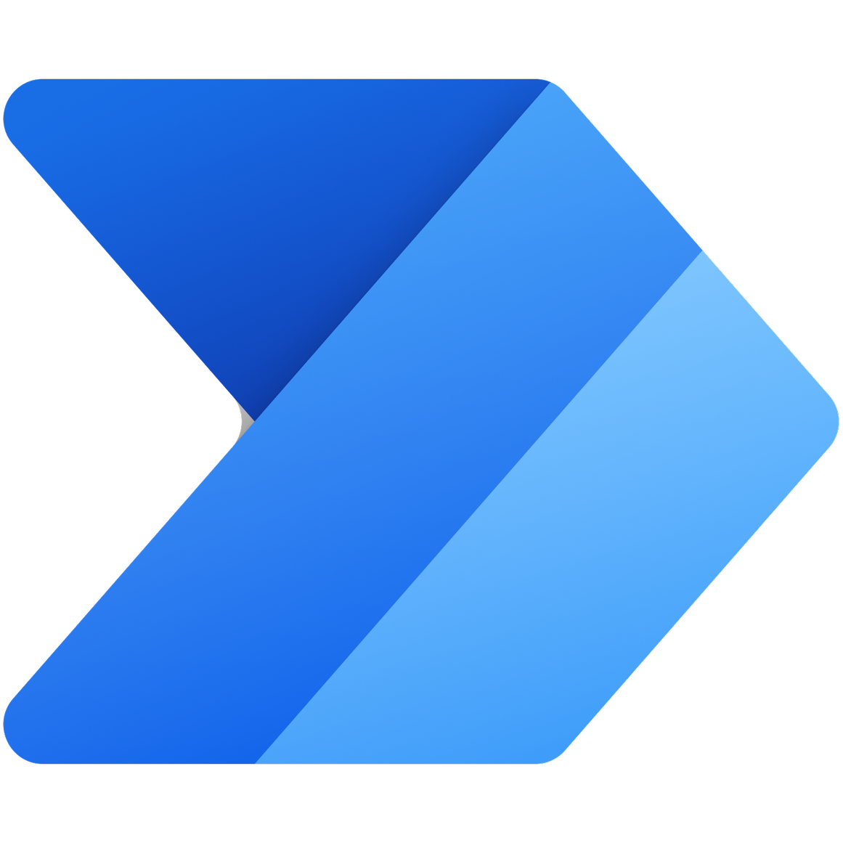



Dataverse is a low code data platform for building Apps
Unified SaaS platform that manages data & logic for Dynamics 365 and Power platform
Dynamics 365
Intelligent Business Apps
Power BI
Business analytics
Power Apps
Application development
Power Automate
Workflow automation
Power Virtual Agents
Intelligent virtual agents
Power Pages
Webpage development
Business Logic
Jobs
Plugins
Business Rules
Power Fx
Intelligence + Analytics
Synapse Link
Reporting
Duplicate Detection
Business Q&A
Rollups
Integration
Business Events
M365 Loops
Dataflows
App + Data Lifecycle
Retention Policies
Azure DevOps
GitHub
Dataverse
Data Storage
Files & Blobs
Relational
Semi Structured
Logs
Search Indexes
Connectors
Security + Governance
Authentication
Authorization
RBAC
Auditing
Customer Managed Key
Private Link
Notes:
Dataverse is the low code SaaS data platform for building Apps – it contains many Azure services needed to build and manage data for apps like Dynamics and PowerApps.
----------------------------------------------------------------------------------------------------------
Done by integrating, wrapping, and orchestrating dozens of underlying PaaS services
The most common services needed to integrate with your data to build end to end applications
Dataverse is managing all of these components as part of its underlying infrastructure for each Dataverse instance created
And it’s all interconnected so the definition of the data can flow through as needed removing a lot of the scaffolding typically needed for building complex applications
All of that managed infrastructure isn’t exposed directly but rather wrapped and exposed with low-code experiences
Through simple click and configure experiences, citizen developers are provided the building blocks to create rich data applications and automations without needing any professional development
Because Dataverse understands the most common needs and capabilities, it can expose and interconnect the capabilities in a turnkey fashion
And finally as the low-code backend for the Power Platform, it is deeply integrated throughout the Power Platform products
Each of these systems, natively interact with Dataverse as the backend providing unique and distinct value for users

Slide 7
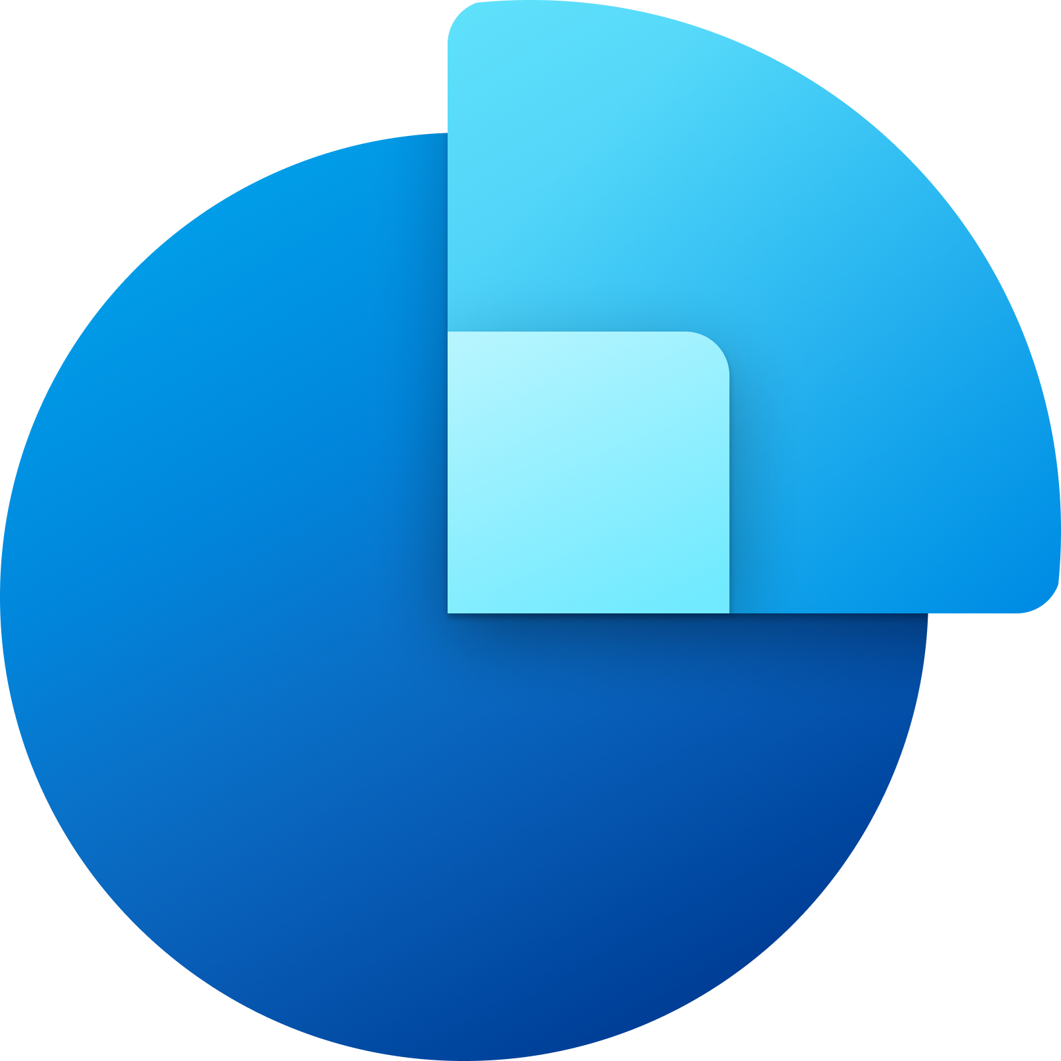

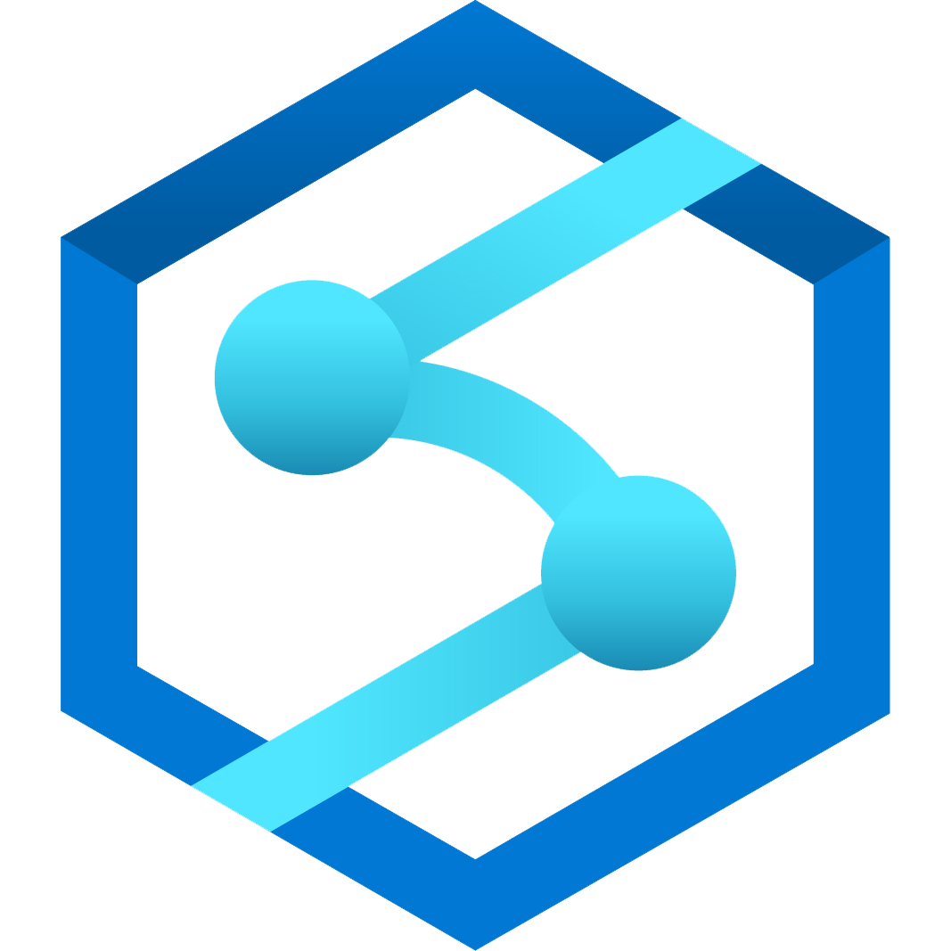



Synapse Link for Dataverse
Generally Available
Power Apps
Dynamics 365 Sales
Dynamics 365 Customer Service
One-click export of Dataverse data into Synapse for analytics
Continuous replication of standard and custom tables to Azure Synapse Analytics ​
Now supports F&O Tables & Entities
Dataverse
Dynamics 365 Field Service
Dynamics 365 Marketing
Dynamics 365 Finance and Operations
Notes:
Synapse Link for Dataverse enables Dynapse365 and Power Apps customers to integrate sales, customer service, field service, marketing and Finance and Operations data into Synapse. Once the initial seeding of data is completed, incremental updates will continually run to enable analytics on the most recent and relevant version of the data.

Slide 8
Demo: FnO data in Synapse Link
For extensive demos, check out the TechTalk series on this topic at
https://aka.ms/TransitiontoSynapseLinkVideos

Slide 9
Dataverse Link to Microsoft Fabric
2
Two-way integration with Microsoft Fabric brings AI driven insights to business data in Dynamics 365 and Power Apps
Notes:
Microsoft Fabric is an all-in-one analytics solution for enterprises that covers everything from data movement to data science, Real-Time Analytics, and business intelligence... it's a data platform for the era of AI, that accelerates and streamlines the your ability to meet your analytical needs.

Slide 10






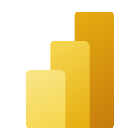
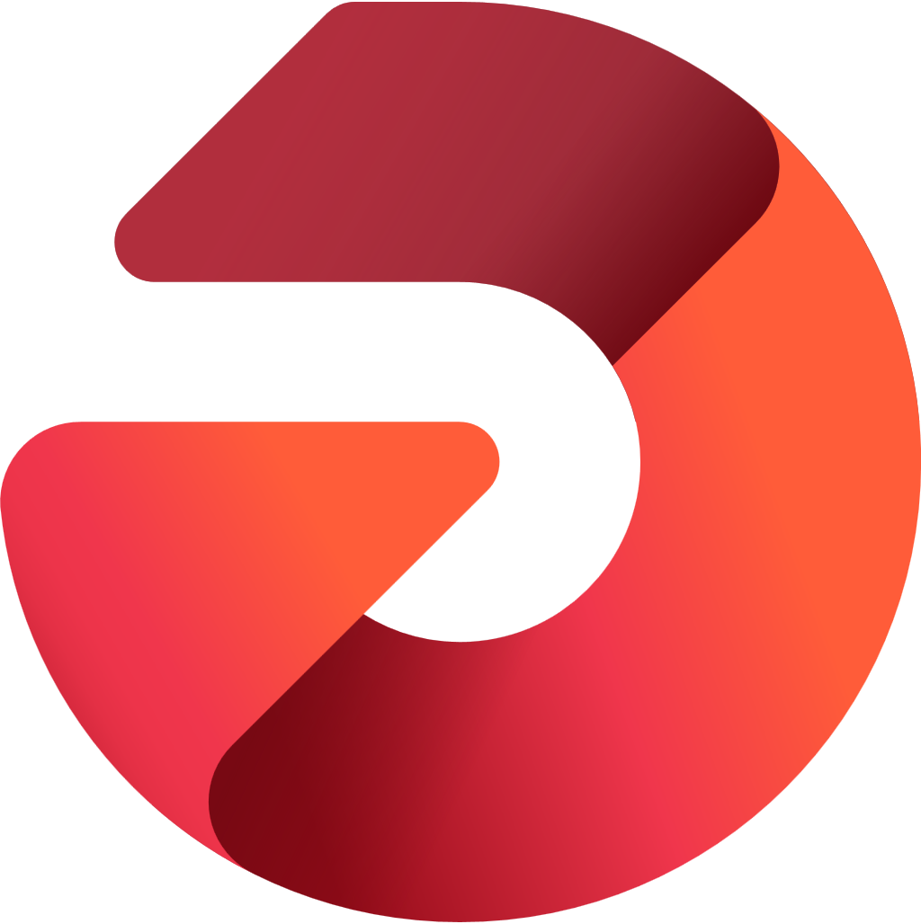

Microsoft Fabric
Data analytics for the era of AI
Data
Factory
Synapse Data
Engineering
Synapse Data
Science
Synapse Data Warehouse
Synapse Real Time Analytics
Power BI
Data Activator
OneLake
Notes:
Transition to Customer video (Say ‘roll video’)

Slide 11


Power platform & Microsoft Fabric
Generally Available
Power Apps
Dynamics 365 Sales
Dynamics & Dataverse data available in Microsoft Fabric immediately, no ETL, no data copy
​
Dynamics 365 Customer Service
Dynamics 365 Field Service
Dataverse
Microsoft Fabric
Microsoft OneLake
Dynamics 365 Marketing
Dynamics 365 Finance & Supply chain
Notes:
If you are using Dynamics or PowerApps, your data is already in Dataverse. With one click, you can work with your data in Microsoft Fabric. Your data is already in OneLake.

Slide 12





Power platform & Microsoft Fabric
In Public preview
Power Apps
Power
Automate
Dynamics & Dataverse data available in Microsoft Fabric immediately, no ETL, no data copy
Makers can build Apps with insights from Microsoft OneLake no ETL, no data copy
​
Power Pages
Power
Virtual agents
Microsoft Fabric
Microsoft OneLake
Dataverse
Power Fx
AI builder
Notes:
You can use Fabric to work with all the worlds data in One Lake. Data engineers can use SQL, apply AI, combine data, re-shape and build summaries. Get insights on all your data.
Those insights are not useful unless you can take action and drive decisions. With a few clicks, your Data in OneLake appears as tables in Dataverse – you can build Low code apps and build automations.

Slide 13
Transition
3
Upgrade to Synapse Link
Business benefits
Expected effort and timelines
Notes:
Synapse Link is now fully compatible with finance and operations data, so customers can use this guidance to help transition from Export to Azure Data Lake. In this section, we'll examine what's changing, why the transition is important, what are the expected benefits, and how much effort may be entailed.

Slide 14

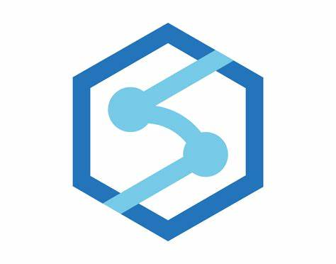
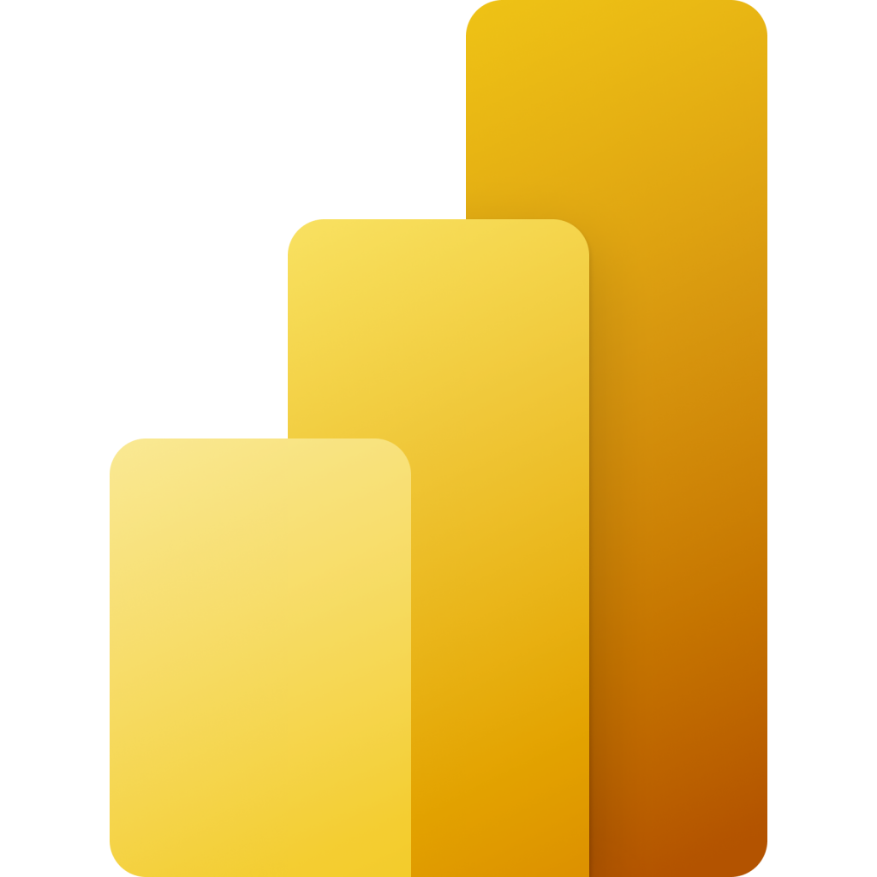
Previously : Synapse Link & Export to Data Lake
Synapse Link for Dataverse
Export to Data lake
Dynamics 365 Finance & Supply chain
Synapse Analytics helps working with data using SQL and other tools
Power BI for data visualization and story telling

Slide 15
One experience to integrate all Dynamics data for Analytics
Synapse Link for Dataverse
One experience to integrate all your data for Analytics
Synapse Analytics helps working with data using SQL and other tools
Power BI for data visualization and story telling
This is an evolution and unification of our approach across Dynamics products

Slide 16

Unlock AI driven insights and action with Link to Fabric
Dataverse Link to Fabric
One experience to integrate all your data for Analytics
Microsoft Fabric combines Synapse Analytics, Power BI and more into a single, unified experience on the cloud
Upgrading to Synapse Link provides a path to innovations in Microsoft Fabric

Slide 17
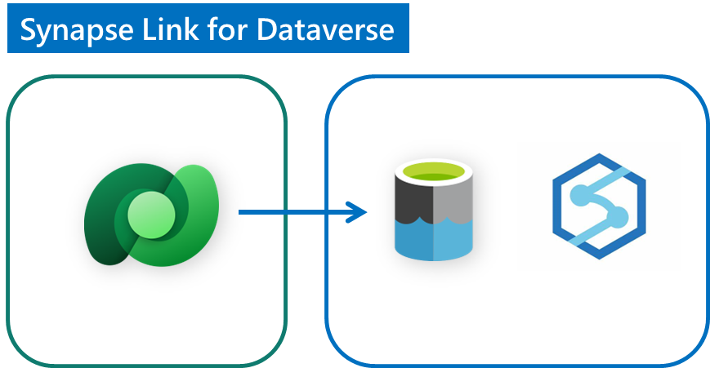
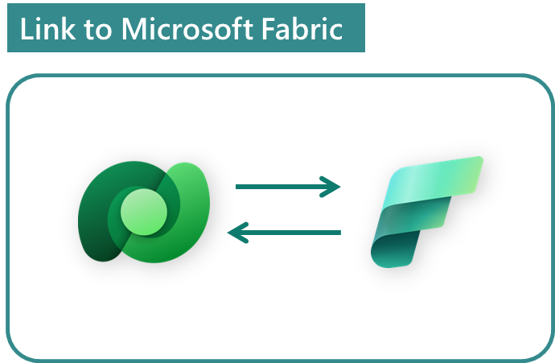
Extend your investments to AI driven insights & action
This is an evolution and unification of our approach across all Dynamics products
Legacy data integration services
Data Export Service (DES)
Bring your own DB (BYOD)
Export to Data Lake
Generally available
Generally available
Upgrade to Synapse Link*
Low code insights & action
Simplify data integration & Reduce total cost of ownership
Data shapes remain the same – no need to re-build
No-ETL, no-copy, two-way integration enables Low code makers
AI driven insights & action with built-in Copilots
* Existing customers have until 1-Nov-2024 to transition from Export to Data lake to Synapse Link. We advise new customers to use Synapse Link

Slide 18
Extend your investments by upgrading to Synapse Link
This is an evolution and unification of our approach across all Dynamics products
Extend your existing investments
Same data shapes
Minimal changes to existing pipelines
Reduce operational costs
Easy to configure and manage
Built-in integration with Synapse and Microsoft Fabric
No impact to operational workloads
Efficient reporting with Delta/ Parquet
Near real time operational reporting
Faster queries & reports, smaller files
Synapse Link for Dataverse
Continuous export to Data lake enables easier integration for IT admins and Data engineers

Slide 19
What are the benefits – deep dive
Area | What is changing | Effort | Value add
Admin and setup experience | LCS to Power platform maker portal for setup and add tables | Admin user training | Data from all Dynamics apps available in a simple experience
Tables available to use | Tables must have row version change tracking enabled Common OOB already enabled | One-time small X++ effort to extend missing OOB or custom tables | # of table limit is not applicable Default support for large memo fields
Change tracking mechanisms | CDC to Row version change tracking | No effort | Lower impact on operational database Full refresh is not needed to recover from failure/Database failovers/ movements
Integration with Synapse and Microsoft Fabric | No need of CDMUtil | Saved effort | Configures & connects Synapse workspace and Microsoft Fabric
Data format | Data format changes from CSV to delta lake BYOL – Customer Synapse Spark for delta conversion | No effort | Faster queries, smaller files, no update conflicts Integrated with Microsoft Fabric data platform for the age of AI
Data transformation/ETL | Adapt to any small audit field changes in ETL and data locations as applicable | Low effort to adapt
Incremental data Integration | Adapt to Synapse link folder structure and audit fields and incremental logic | Low effort – adjusting the incremental pipelines to new Fasttrack guidance and sample available | Simpler logic to process full and incremental data with single pipeline
BI & Reporting | No change expected

Slide 20
Empower your people to do more with data
No data copy, no ETL, no third-party tools
Data stays in Dataverse – secure access in Fabric
No need to bring storage - uses DV storage
Upskill your Low code users to do more with data
Easy to configure and manage
Build PowerApps and act on insights from Fabric
No impact to operational workloads
Talk to your data, ask questions with conversational AI
Help from Copilots in Microsoft Fabric to get work done faster
Bring back insights from Fabric and build PowerApps
Link to Microsoft Fabric
No copy, No ETL, two-way integration enables Low code users to do more with data

Slide 21
Upgrade to Synapse Link: Total cost of ownership
A cost comparison for Operational reporting with near-real time reporting*
 | Export to data lake | Synapse Link for Dataverse
Start-up & configuration - Additional software licenses - System configuration - Data migration/initialization - Development and validation |  | Simpler configuration experience
Operating Costs - Data integration - Azure storage staging area - Data pipelines - Data ingestion into SQL or Dwh - Development/ maintenance | Azure storage Synapse Analytics (SQL query) Data Factory jobs SQL or Data warehouse storage Mts. of data pipelines | Azure storage costs - ~60% less due Synapse analytics (spark) - +$300-$3,000 mo*
Operating Costs – Reporting - Power BI datasets - Reporting | Synapse analytics (SQL Query) Power BI capacity

Slide 22
Operational reporting cost comparison
 | Export to data lake (CSV) | Synapse Link for Dataverse (Delta)
Data storage | Total DB – 615 GB Varies by table, ex. INVENTTRANS: 1.3GB | Total: 98 GB (6x compression) INVENTTRANS: 360MB (6x compression)
Operating Costs – data integration | Data Factory jobs SQL or Data warehouse storage Mts. of data pipelines | Synapse analytics (spark) - +$300-$3,000 mo*
Operating Costs – Query and reporting | Synapse query - $10,630 /month (1) | Synapse query - $ 1,701 /month (2) (6x reduction)
NOTE 1: Synapse Query charges based on total data processed, which in this case was 2,126 TB (@$5/TB)
NOTE 2: 10x query cost reduction due to
10x data compression
Delta/parquet format is more efficient Partition elimination

Slide 23
Demo: Explore cost reductions
For extensive demos, check out the TechTalk series on this topic at
https://aka.ms/TransitiontoSynapseLinkVideos

Slide 24
Call to Action
4
Plan to transition
Learn more from community and Microsoft Team
Frequently Asked Questions
Notes:
Product roadmap is subject to change and dates provided are estimates.

Slide 25
Call to Action
Learning
Learn about the upgrade and improvements (this deck)
Deep dive into individual architecture patterns deep dive
Configure a test environment and give it a try
Review patterns and transition guidance https://aka.ms/TransitiontoSynapseLinkVideos
Join the community https://aka.ms/SynapseLinkforDynamics
Plan transition
If you are using Export to data lake – plan for transition
If you are planning to go live soon – adopt Synapse Link from start
Realize benefits of transition
Simplify reporting with Delta
Optimize your architecture with Microsoft Fabric

Slide 26
Resources
Documentation
PowerPoint
Export to Data Lake transitions to Synapse Link – Overview (this deck)
Export to Data Lake transitions to Synapse Link – architecture patterns deep dive
Synapse Link
Azure Synapse Link - Power Apps | Microsoft Learn
Create an Azure Synapse Link for Dataverse with your Azure Synapse Workspace - Power Apps | Microsoft Learn
Export Microsoft Dataverse data in Delta Lake format - Power Apps | Microsoft Learn
Choose finance and operations data in Azure Synapse Link for Dataverse - Power Apps | Microsoft Learn
Use managed identities for Azure with your Azure data lake storage - Power Apps | Microsoft Learn
Microsoft Fabric
Dataverse direct integration with Microsoft Fabric - Power Apps | Microsoft Learn
Microsoft Fabric documentation - Microsoft Fabric | Microsoft Learn
Yammer group
Viva Engage- Synapse Link for Dynamics
Video
Dataverse
Dynamics 365 Bites - Synapse Link for finance and operations apps - Getting started (preview) | August 2023
(2747) Build 2023: Dataverse integration for Microsoft Fabric - YouTube
Microsoft Fabric
(2747) Microsoft Fabric: Satya Nadella at Microsoft Build 2023 – YouTube
Microsoft Fabric Launch Digital Event (Day 1) – YouTube
TechTalk Series
https://aka.ms/TransitiontoSynapseLinkVideos

